Slide 1
Major tourist spots in Bangladesh
Course Instructor: FARHANA AFROZ

Slide 2
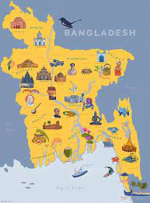
Introduction

Slide 3
Types of tourist places :
Mesmerizing natural locations
Historical heritage
Spiritual destination
Symbol of nationalism and solidarity

Slide 4
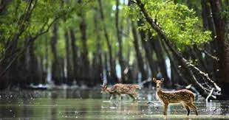

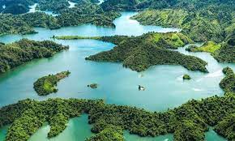
.
Mesmerizing natural locations:
• Longest sea beach cox bazar
• Mangrove forest Sundarban
Rangamati
• Kuakata
• Jaflong
• Tea garden Srimongal

Slide 5
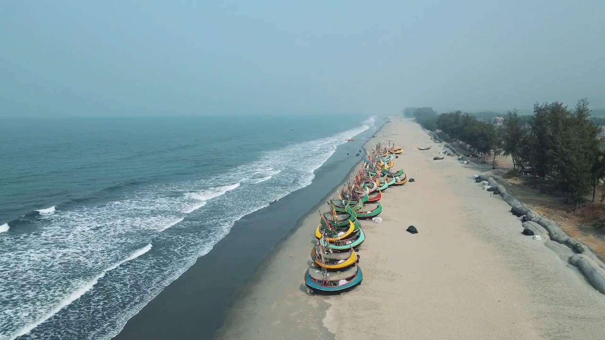
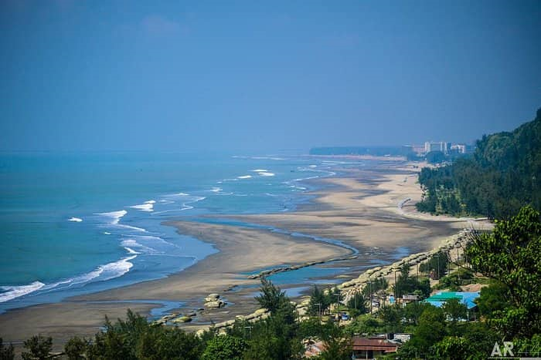
Cox’s bazar:
unbroken length of 155 km
longest sea beach in the world

Slide 6
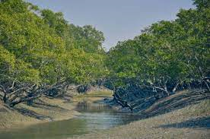
Sundarban:
the largest mangrove forest in the world.
best tourist destination for the people who love forest as well as wild animals.
The Royal bengali tigers are only seen in this forest around the world.
top attractive natural tourist place in Bangladesh.

Slide 7
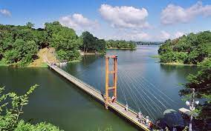
Rangamati :
For having red soil, this district name is Rangamati.
has also many attractive natural tourist place.
Subhalang Hill, capital lake hanging bridge, echo Village and more.

Slide 8
Historical heritage:
Lalbagh Fort
Ahsan Manzil
Maynamoti
Mahasthangarh
Sonargaon

Slide 9
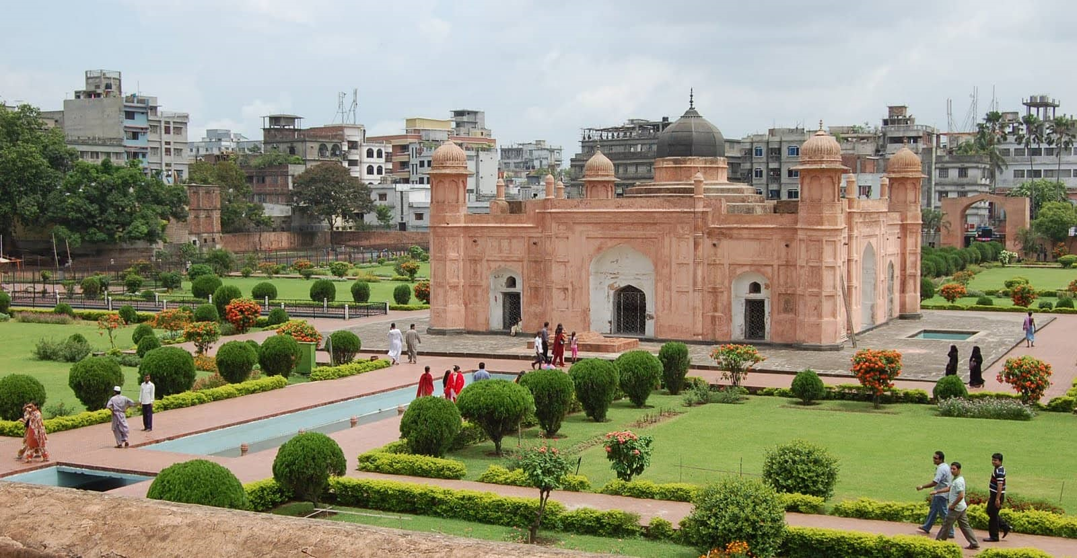
Lalbag Fort:
an incomplete Mughal Palace .
situated at the Buriganga River in the south western part of Dhaka.

Slide 10
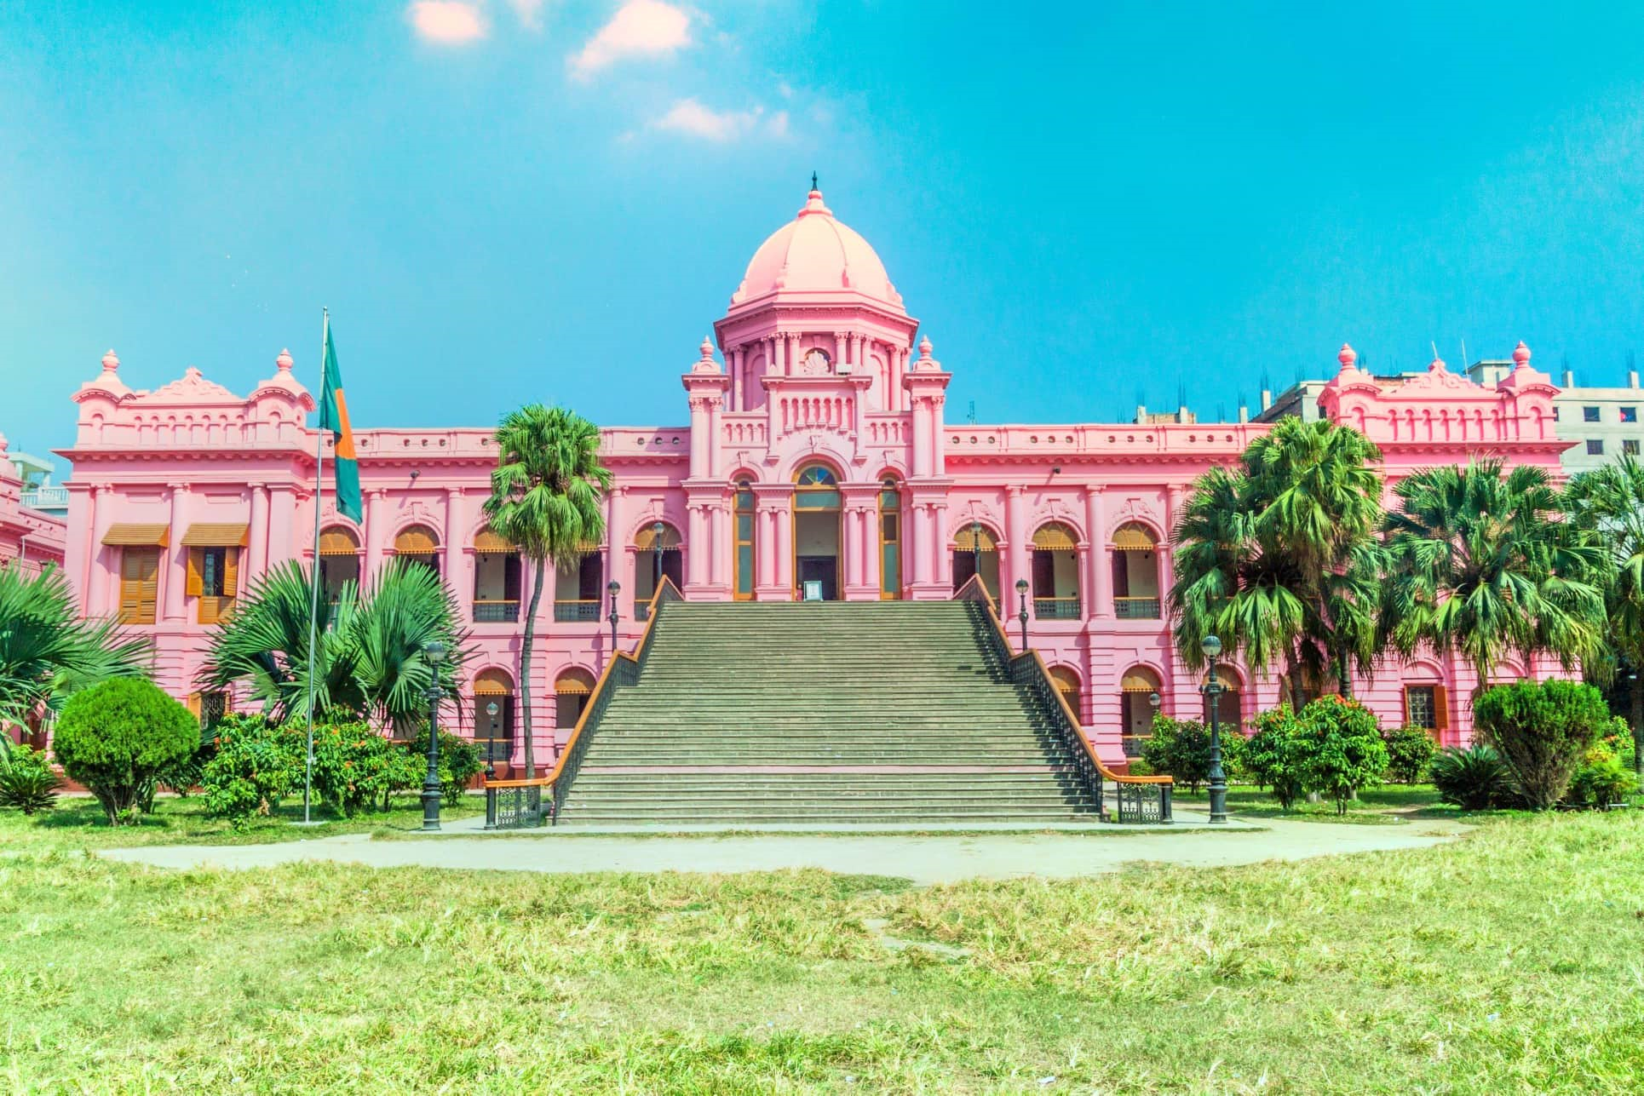
Ahsan Manzil:
the official residential Palace .
seat of the Dhaka Nawab family.
This Palace is now a museum.

Slide 11
Spiritual destination:
Shat Gumbuj Mosque
Shiva temple in puthia
Golden temple Bandarban

Slide 12
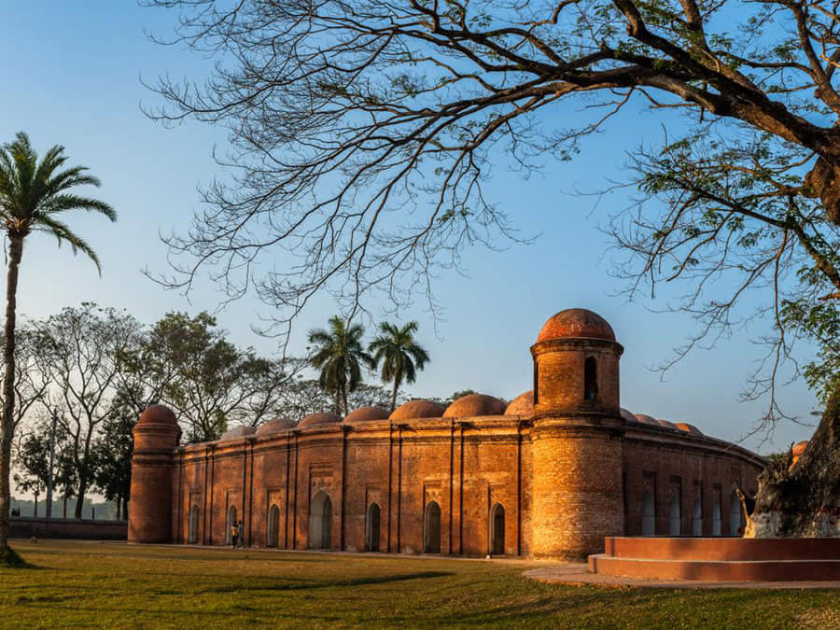
Shat gumbuj mosque:
most magnificent and longest brick mosque in Bangladesh.
world heritage Committee of UNESCO inscribed Bagerhat in the world heritage list
got the status of the second world heritage site in Bangladesh.

Slide 13


.
Symbol of nationalism and solidarity
1. National Memorial : Dedicated to the sacred memory of the people who fought for independence in 1971
2 .Bangabandhu Military Museum : Has a collection of Bangabandhu military history , heritage , success stories and various weapons.

Slide 14
Advantages of Tourism in Bangladesh
Facts:
Driving force for economic growth
Opportunity of changing culture
Supports Balance of Payment (BOP)
Helps in creating employment

Slide 15
Key Benefits:
Economic benefits
Social benefits
Environmental benefits

Slide 16


Slide 17
Problems which faced by tourist
1.Weak Transportation System
2.Intrastructural Weakness
3.Lack of Advertisement
4.Availability of Good Food
5.Security problem

Slide 18
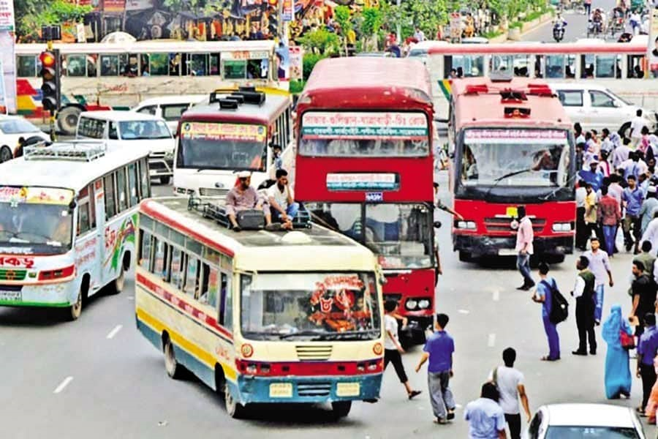
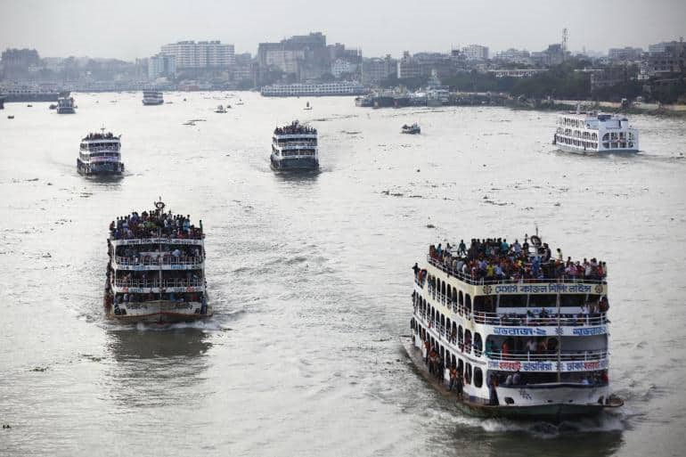
Weak Transportation System

Slide 19


Infrastructural Weakness

Slide 20


Lack of Advertisement

Slide 21
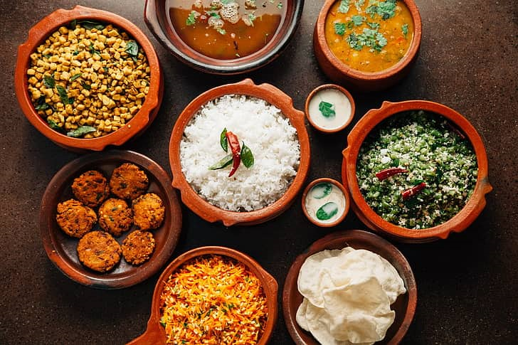

Availability of Good Food

Slide 22

Security Problem

Slide 23
Factors to Improve
Tourism Management
Factors Affecting Environment at Destination
Tourism is in its best form when the destination boasts of conducive climate
Economy of the Country
Historical or Cultural Importance of Destination
Research Importance of Destination
Religious Importance of Destination
Technology.

Slide 24
Conclusion
Bangladesh is a land of beauty. It is a small country but full of tourist spots. Every year a lot of tourists from home and abroad come to visit these sports. There are many tourist spots in Bangladesh. All the tourist spots are very beautiful and wonderful. We can earn a lot of foreign money by developing these tourist spots. Government and people should come forward to take necessary steps to make these spots more attractive to the tourists.

